Slide 1
Learning Git through Dropbox

Slide 2
Why Dropbox?
Many features in Dropbox is evident in Git, therefore understanding Dropbox will be a stepping stone towards your learning of Git.
Dropbox can also be used hand in hand with Git

Slide 3
What is Dropbox?
Dropbox is a free service that lets you bring all your photos, docs, and videos anywhere. Any file you save to your Dropbox will also automatically save to all your computers, phones, and even the Dropbox website. This means that you can start working on your computer at school or the office, and finish on your home computer. Never email yourself a file again! - Dropbox

Slide 4




What is Dropbox? – Diagrams
The Internet
Your Laptop
Dropbox
Dropbox
Synchronize

Slide 5
Diagrams - Explained
Dropbox is basically a storage place where you can keep your files. The dropbox storage will be located in two places, one on the dropbox server on the internet and the other within your local computer. These two storage places will be in sync through the presence of internet connection, which means that any files that you keep within your local computer will be replicated on the dropbox server.

Slide 6
Learning Dropbox
We will be learning how to:
Set up your own identity within the Dropbox community
Share and collaborate your work or files with others through Dropbox.
Track the progress of your files in your Dropbox
Restore your files in Dropbox to a particular version back in time

Slide 7
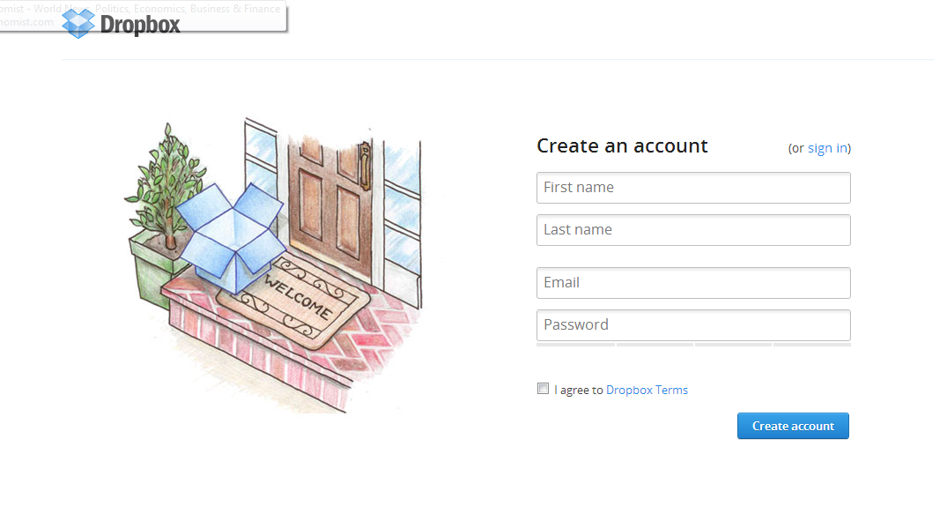
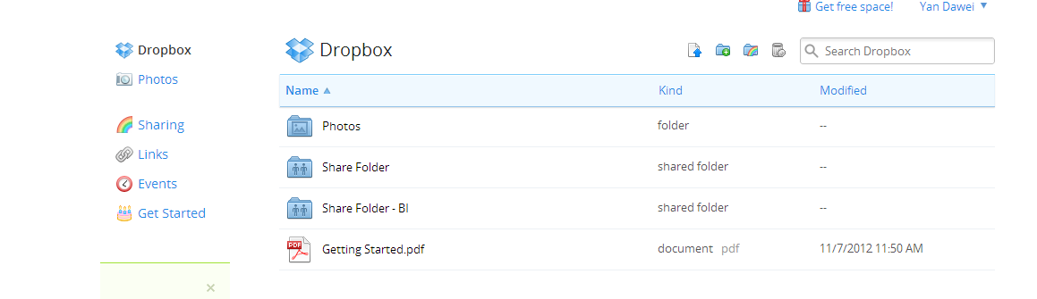
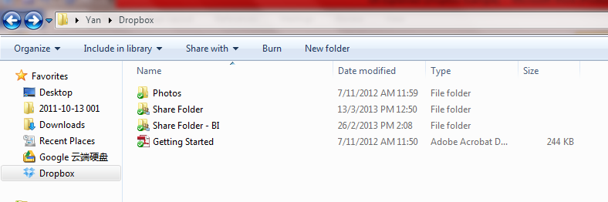
Setting up your identity
Create your Dropbox account
You will have an online storage and a local storage

Slide 8
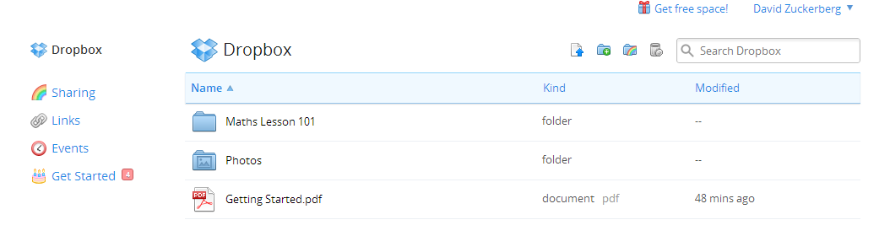
Collaborate & Share
The owner of the shared folder will initiate a share invitation through the share feature
Upon using the share feature, you will be prompted to fill in your counterparty’s particulars as well as indicate the folder that he wish to share.

Slide 9
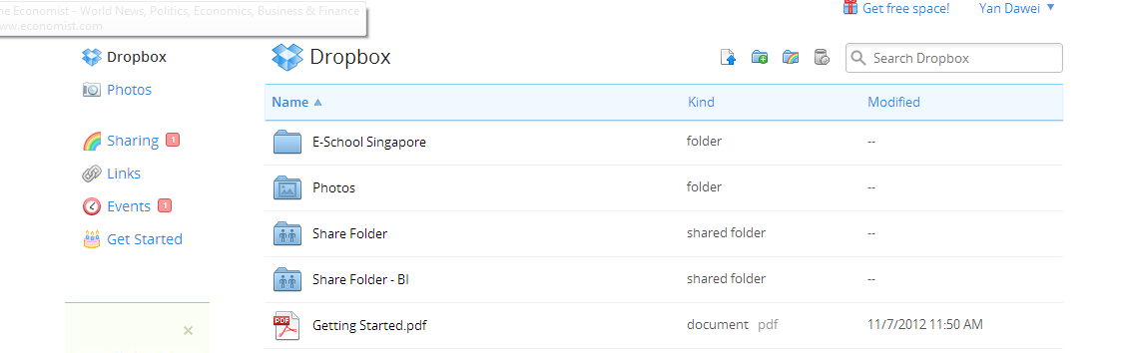
Collaborate & Share
The receiver of the share invitation will be notified.

Slide 10
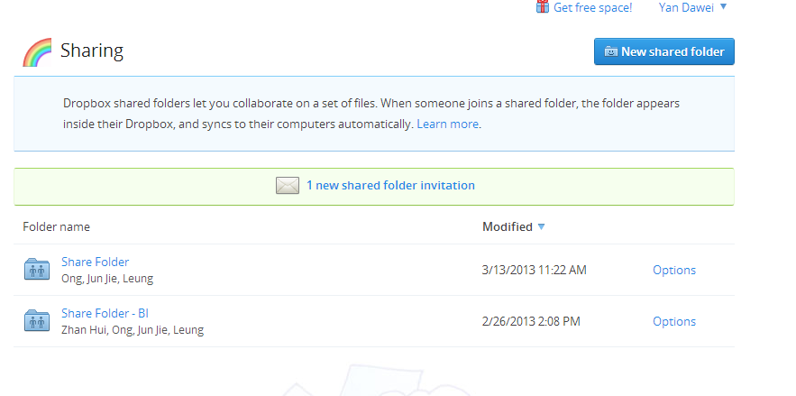
Collaborate & Share
The receiver will have to accept the share invitation to access the shared folder through his dropbox storage

Slide 11
Tracking progress of your work
A very useful feature that dropbox has is that it tracks the progress of your files. While working on something, definitely you will have multiple versions of your work, more so when you are engaged in a team project. What do we do conventionally to manage versions? Create new files for every major change that is incorporated. The problem with this is that it takes up a lot of space. Dropbox helps you to alleviate this problem. It captures versions of your file overtime. Dropbox tells you exactly when is the change, what is the change, who did the change and also allows you to download and view the change.

Slide 12
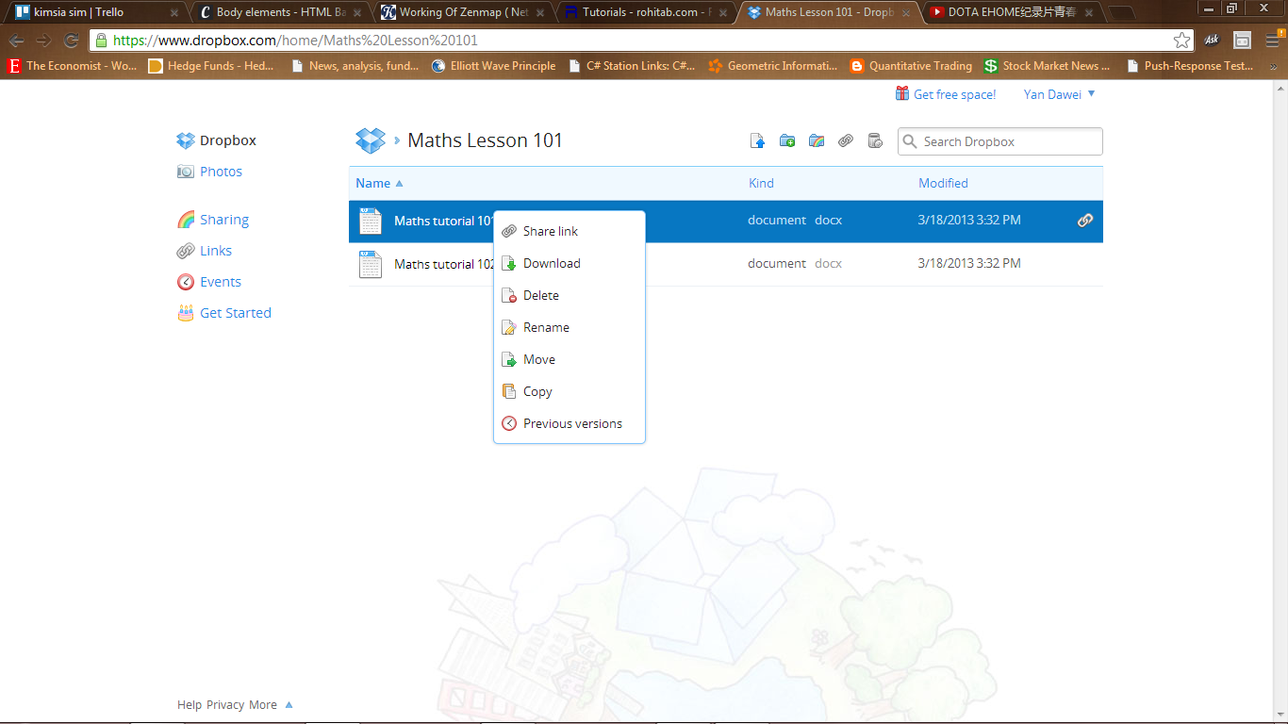
Tracking progress of your work
Right click on any of your files in dropbox and you will notice a “previous versions” feature. Click on it.

Slide 13
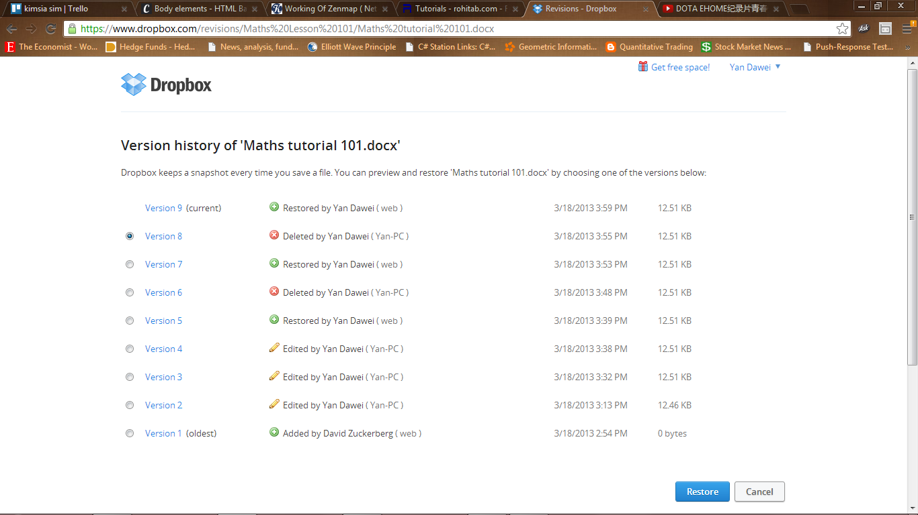
Tracking progress of your work
If you had worked on that file for quite some time, there should be a list of versions that dropbox has captured for you over time. Note that whenever you close the file or delete a file, dropbox will automatically capture that moment as a version number.
Click on any of the versions to download the file

Slide 14
Restoring Your Files
Furthermore, to add onto the view previous feature, dropbox also allows you to change your current file to any of its previous form. This restore feature of Dropbox is one it’s most outstanding features. With it, you will never need to worry about accidentally deleting the wrong files, or making a wrong change to any file.

Slide 15
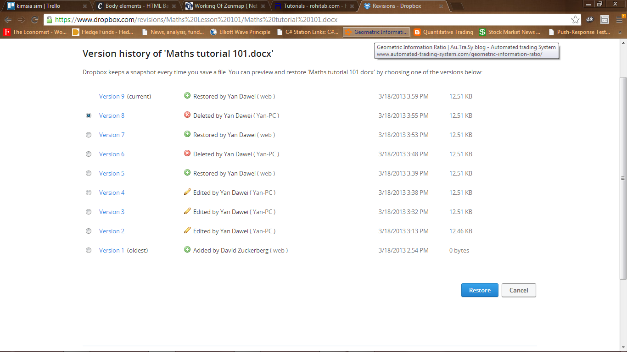
Restoring Your Files
Select the version you wish to restore into.

